Slide 1
Covid-19’s effects on the Nasdaq & Bitcoin Markets
Presented by: Maria Del Valle and Karina Quiroga.
Team: Weiyuan Wu, Giovanny Ruiz, and Dr. Sean Mondesire,
Miami Dade College
Notes:
Karina:

Slide 2

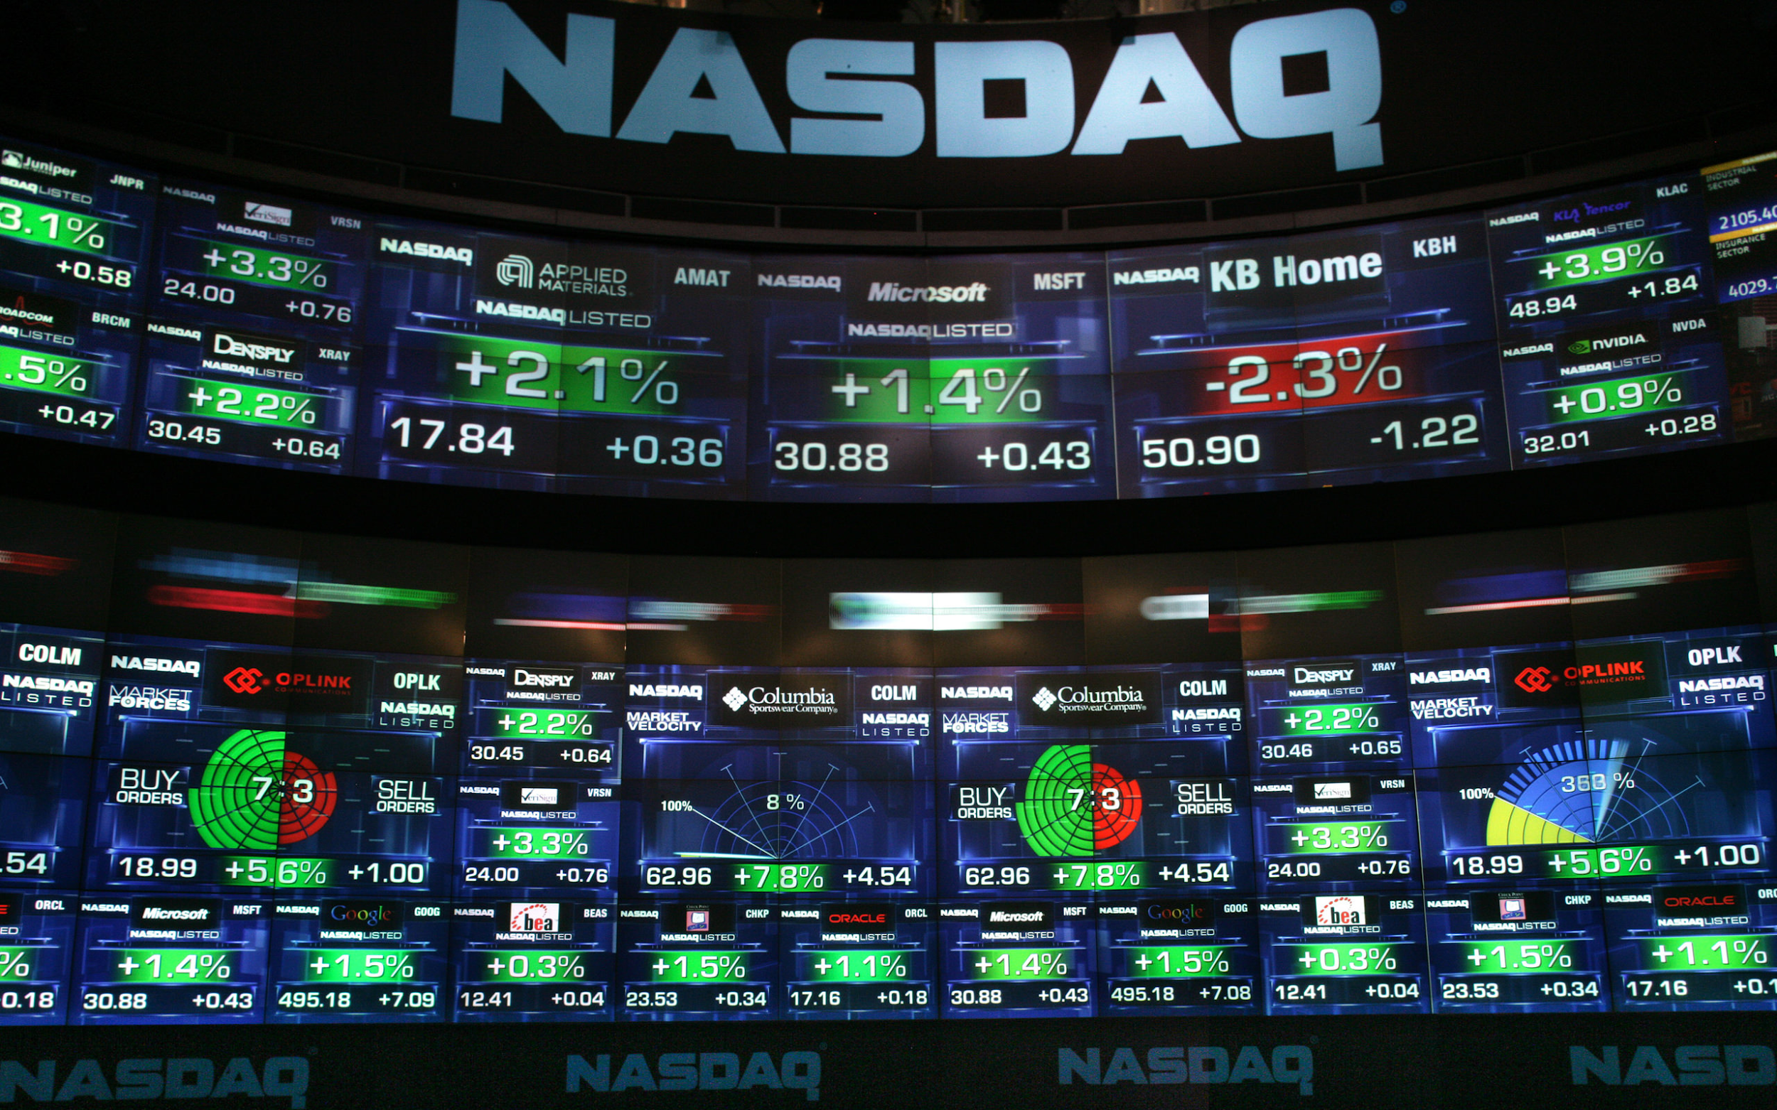

Problem Statement
Has COVID-19 cases and deaths affected the stock and cryptocurrency markets?
Notes:
How covid 19 has affected bitcoin and nasdaq stocks.

Slide 3

Motivation
The Covid-19 virus has changed the world as we know it and its economy along with it.
Notes:
This will help identify why the stock market has fluctuated these last few months and what event caused it.
This research may help predict what will happen to stocks/bitcoins when COVID-19 [3] cases increase or decrease in the future.
In case of a future pandemic, it will be better known as to what may occur to the stock market as new information arises and as the country responds.
Can help shareholders make decisions about their shares based on past events and fluctuations seen from the research.

Slide 4

Background
What is Nasdaq?
What is Bitcoin?
How does this affect
the world?
Notes:
Nasdaq index is a collection of prices from all the companies listed in the exchange such as microsoft, amazon, netflix, and can be used as an indicator as to how the U.S corporations are doing.
Bitcoin is a digital currency that has a decentralized authority meaning it is not a government-issued currency. The balances are kept in a public ledger for transparency and it is
not backed up by any bank since there is no physical Bitcoins per say.
Now, how are these two markets related to the covid-19? They are very distinct from one another and that makes them good broad indicators as to if the current pandemic has influenced their markets.

Slide 5

Methodology
Downloaded Bitcoin, Nasdaq, and COVID-19 events data.
Organizing and merging data.
Create visualizations for Bitcoin and Nasdaq vs COVID-19.
Do statistical analysis.
Notes:
-- We began our research is by downloading and collecting all the nasdaq, bitcoin and covid data we could get.
-- merged the data and combined in order to form a table that could be utilized to create visualizations.
-- created plots comparing the markets to covid events and cases. Used python and the libraries matplotlib to create these visuals.
--Calculated correlation values and did hypothesis tests.
--Finally we did a statistical analysis and concluded our finding.

Slide 6
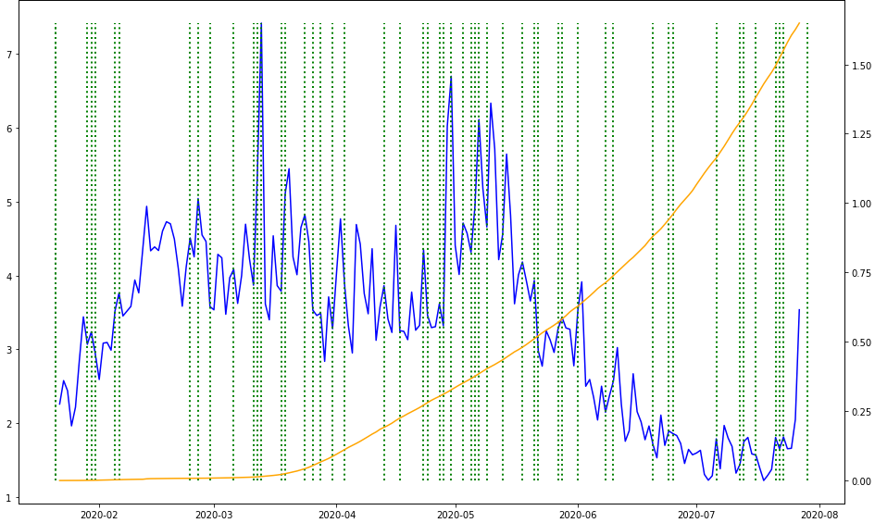
COVID-19 vs financial market volatility analysis
Ie10
Bitcoin Volume vs Global Covid-19 total cases
Ie7
Bitcoin Volume
Case number
___ Global total cases
----- Covid-19 events
___ Bitcoin Volume
Month
Notes:
This table is a visual representation on how the Volume in Bitcoin decreased, as seen in blue, and the total covid-19 cases in orange increased.As exhibited in the middle of the month of May there is a significant decrease Volume. This relationship is negative as manifested later on in the correlation table of values.

Slide 7
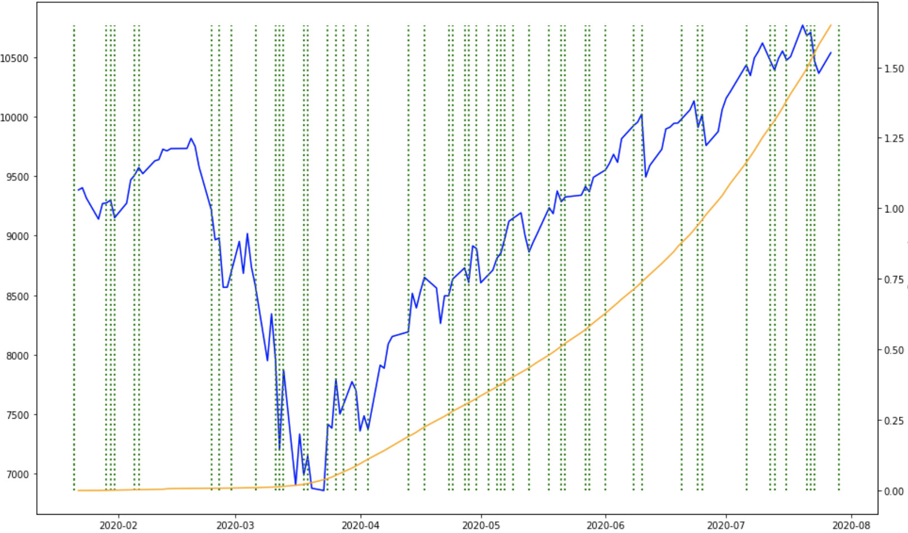
COVID-19 vs financial market volatility analysis
Nasdaq Close vs Global Covid-19 total cases
Ie7
Nasdaq Price
Case number
___ Global total cases
----- Covid-19 events
___ Nasdaq Price
Month
Notes:
This graph, similarly to the bitcoin one, shows how as the global total cases increase the nasdaq price increases as well. This means that they have a positive correlation. As seen here the cases begin to increase late march and that is when the nasdaq price begins to increase as well.

Slide 8
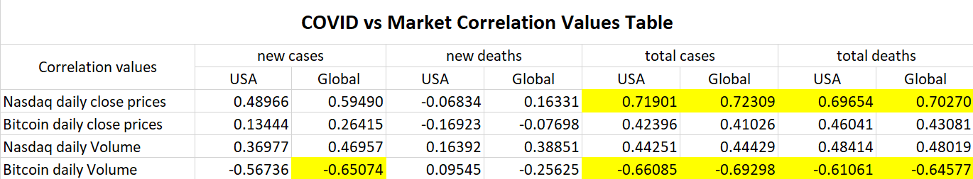
Discussion
Notes:
This table supports the previous graph because the correlation values for total cases and deaths are near 1 and therefore demonstrate how there is a positive correlation between cases and nasdaq close prices.

Slide 9
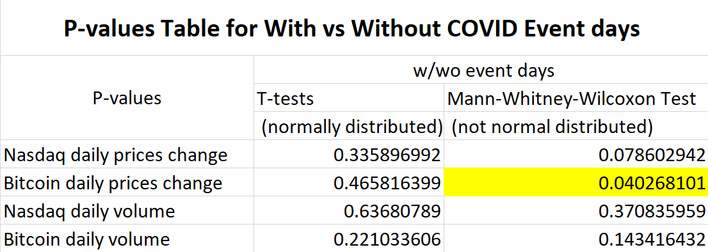
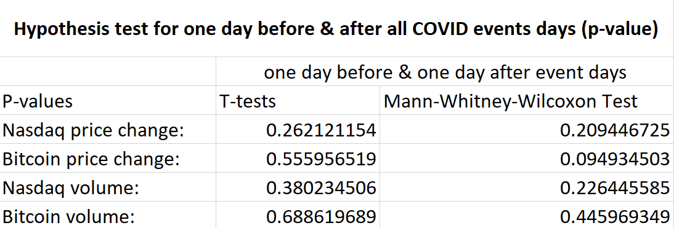
Discussion

Slide 10
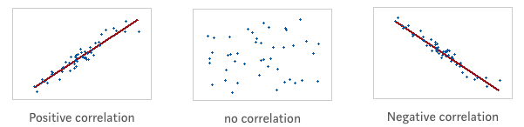
Conclusion
There is a significant difference between “event days” and “no event days” in Bitcoin price change.
Based on the values in the correlation table, Nasdaq daily close prices have a moderately positive relationship with the total cases and deaths both in the U.S and globally.
Bitcoin daily volume has a negative relationship with the total cases and deaths.
Notes:
When the total deaths both in the U.S.A and globally rose, Nasdaq daily close prices increased and had a positive relationship with the covid-19 data globally and U.S. The positive correlation can be seen in the bottom left photo.
Bitcoin on the other hand a negative relationship with the total covid-19 cases, meaning there was less movement buying and selling.

Slide 11
References
“Bitcoin USD (BTC-USD) Stock Historical Prices & Data”. Accessed on August 24, 2020. https://finance.yahoo.com/quote/BTC-USD/history?p=BTC-USD
“NASDAQ Composite (^IXIC) Historical Data”. Accessed on August 24, 2020. https://finance.yahoo.com/quote/%5EIXIC/history?p=%5EIXIC
Parker, Edward. “COVID-19 tracker”. https://shiny.rstudio.com/gallery/covid19-tracker.html. Accessed on August 24, 2020.
Amadeo, Kimberly. “How the Stock Market Works”. https://www.thebalance.com/how-does-the-stock-market-work-3306244. Accessed on August 24, 2020.
Nasdaq logo. Accessed on august 24, 2020. https://commons.wikimedia.org/wiki/File:NASDAQ_Logo.svg
Bitcoin cryptocurrency icon. Accessed on August 24, 2020. https://www.pikrepo.com/fyhre/illustration-of-bitcoin-cryptocurrency-icon
Trading app screen. Accessed on August 24, 2020. https://www.pxfuel.com/en/free-photo-oyvxp

Slide 12
Acknowledgements
The original research summarized in the following was supported, in part, by U.S. Department of Education grant award P031C160161 (STEM SPACE). Any opinions, findings, and conclusions or recommendations expressed in this material are those of the authors and do not necessarily reflect the views of the funding agency.

